Slide 1
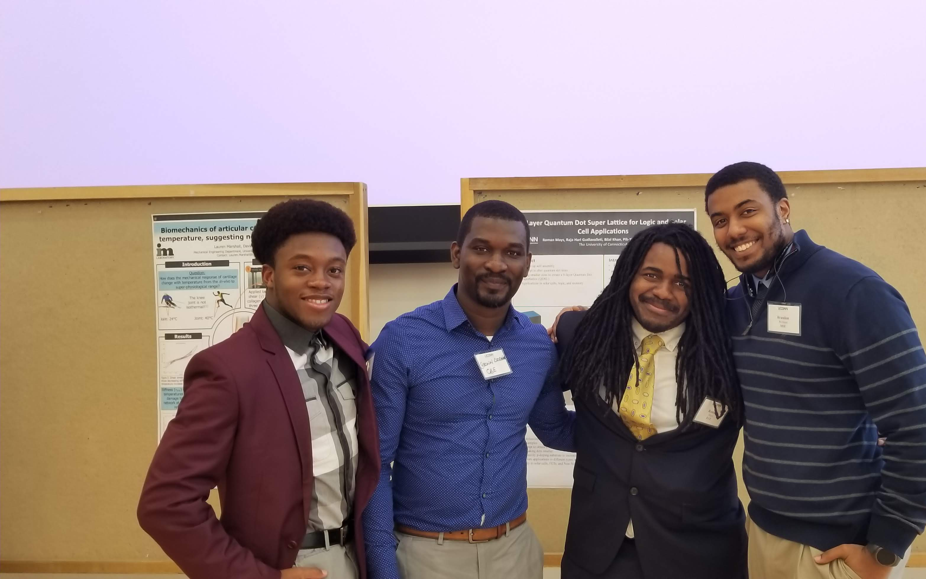
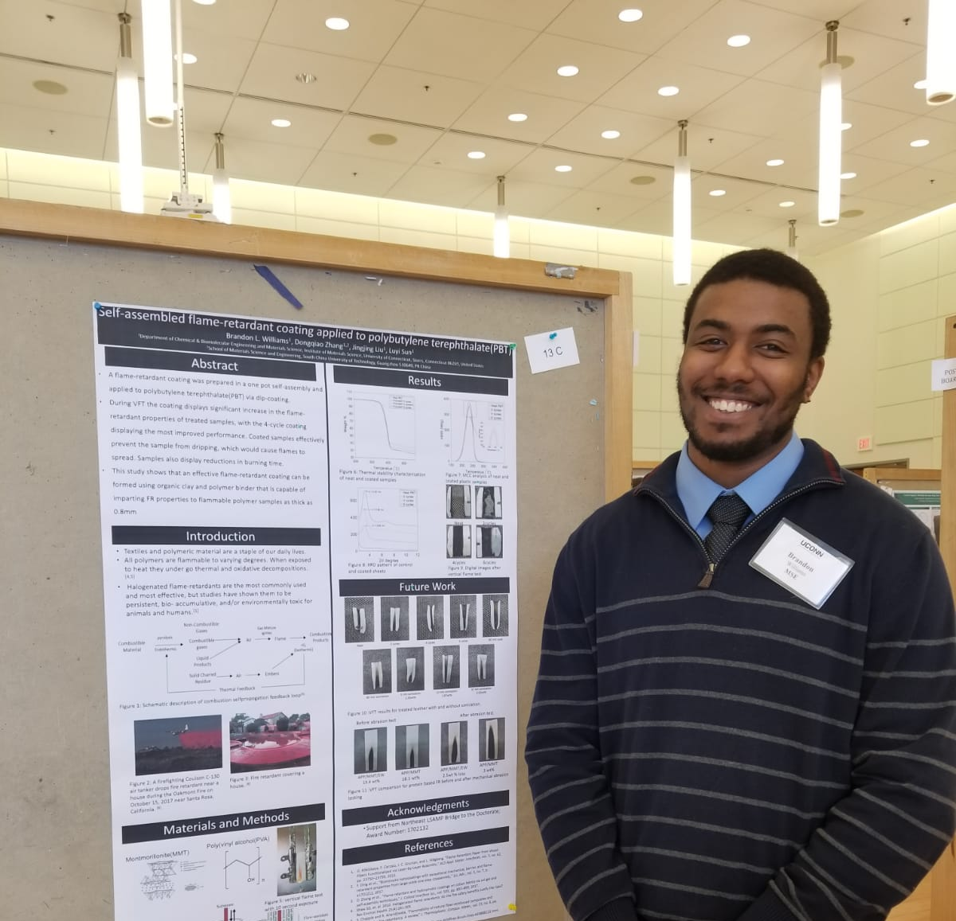
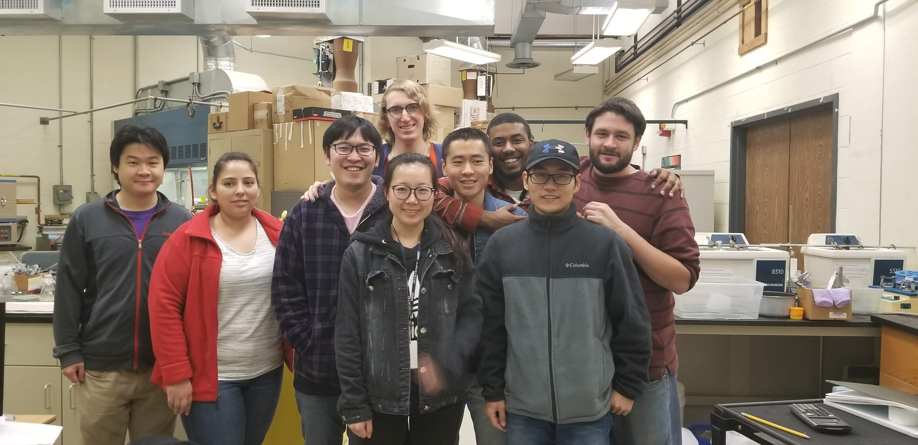
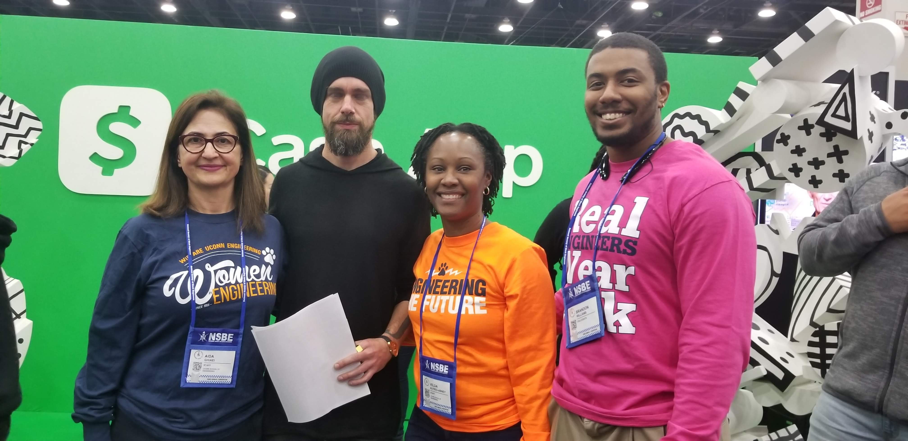
What has BD meant to me!
Who am I?
Brandon L. Williams
Materials Science Ph.D. Candidate (2020)
Advisor: Dr. Luyi Sun
Giolas-Harriott Fellow
NSF BD Fellow
Full GEM Fellow : Owens Corning
Where do I start!
Funding
A (fiscally) worry free Ph.D.
Fellowship
A supportive community that looks like and understands me!
Outreach
Chances to help other students navigate academia!

Slide 2
Goals of UCONN LSAMP Bridge to the Doctorate Program
increasing the number of underserved and underrepresented students who obtain a Ph.D. in Science, Technology, Engineering, and Mathematics (STEM) disciplines is a collaborative effort
encourage and educate the next generation of researchers are colleagues from other LSAMP colleges and universities across the United States
faculty from the CLAS, SoE, CANHR, Pharmacy are engaged and work closely to provide students with academic preparation, mentoring, research experiences, and professional development opportunities necessary to prepare them for STEM careers in academia and in industry

Slide 3
What we do
The LSAMP BD program is charged with enrolling, retaining, and graduating doctoral students from STEM disciplines at UCONN
Through this program, fellows receive various forms of academic support and partake in professional development activities.
These opportunities are facilitated by the School of Engineering office of the Dean and their respective academic departments.
These activities are designed to stimulate the continued development of research and academic skills, and to provide a venue for cultivating creativity and the exchange of ideas.

Slide 4
Support Highlights
Fellows receive:
$32,000 stipend for the first 2 years of doctoral study
Full tuition support
Health insurance
Professional Development and Networking
One on one mentoring with the program director
Peer mentoring opportunities
Community building and support system

